Slide 1



Dance with Emily
Final Presentation

Slide 2
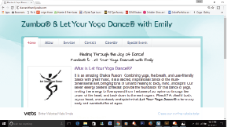
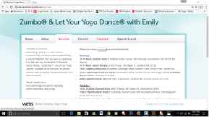
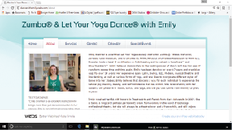
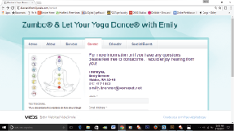
Current Website
http://dancewithemily.webs.com/

Slide 3
Need Assessment
Website Goals: maximize new opportunities, networking, and boost class attendance with a new professional looking website and access to contact information
Mission: Emily believes that the greatest spiritual therapy is movement to music and wants to share this experience with others through her mission “healing through the joy of dance”
Chakras: Let Your Yoga Dance uses each rainbow color of the 7 chakras to stimulate, open, cleanse, and create balance. Rainbow colors also hold special meaning for Emily.
Design Choices:
Accessible contact info on all pages
Prominent feature of mission
Use of rainbow in website design

Slide 4
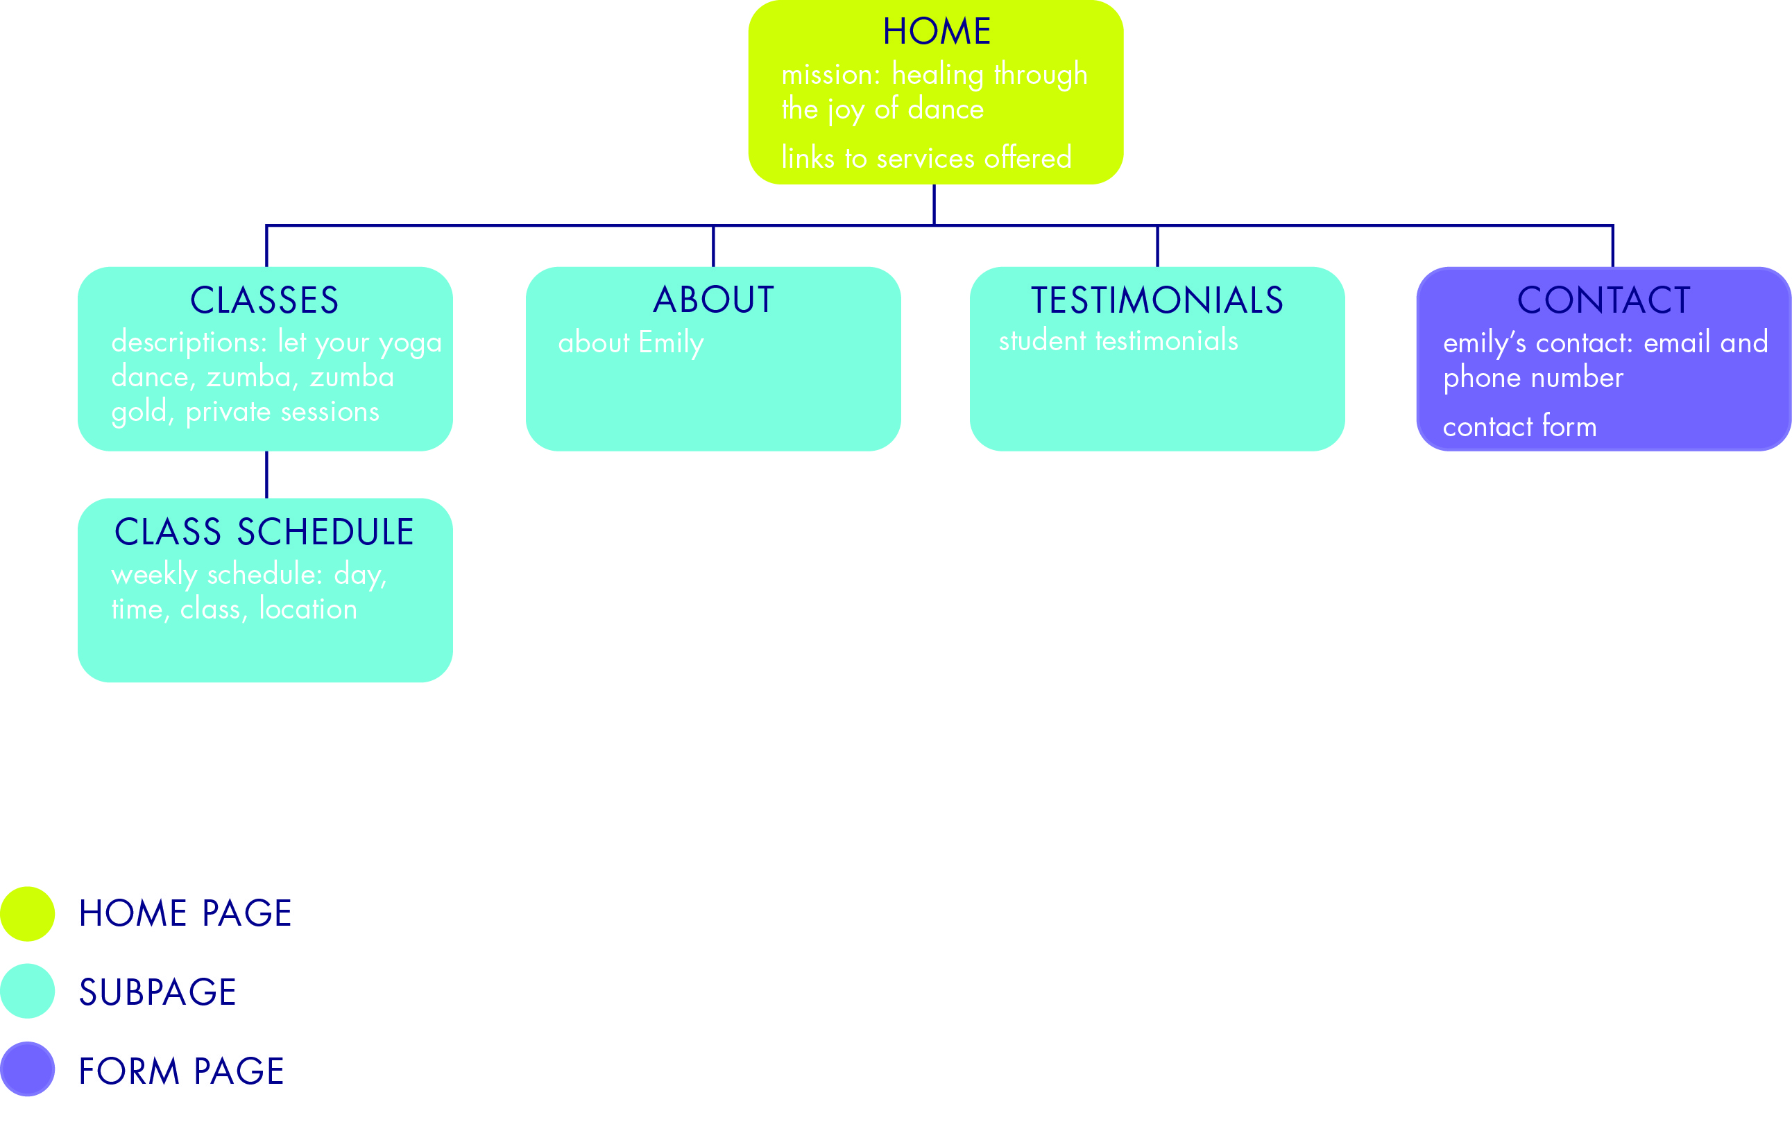
Architecture Diagram
Changes
Class Schedule on level as all sub pages
No contact form

Slide 5
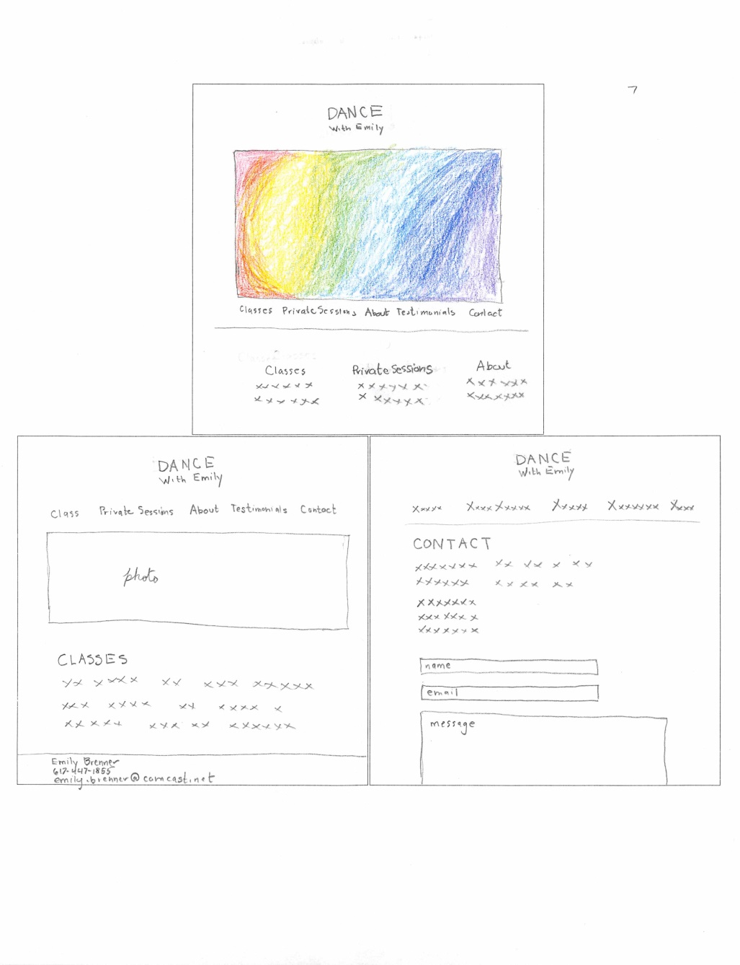
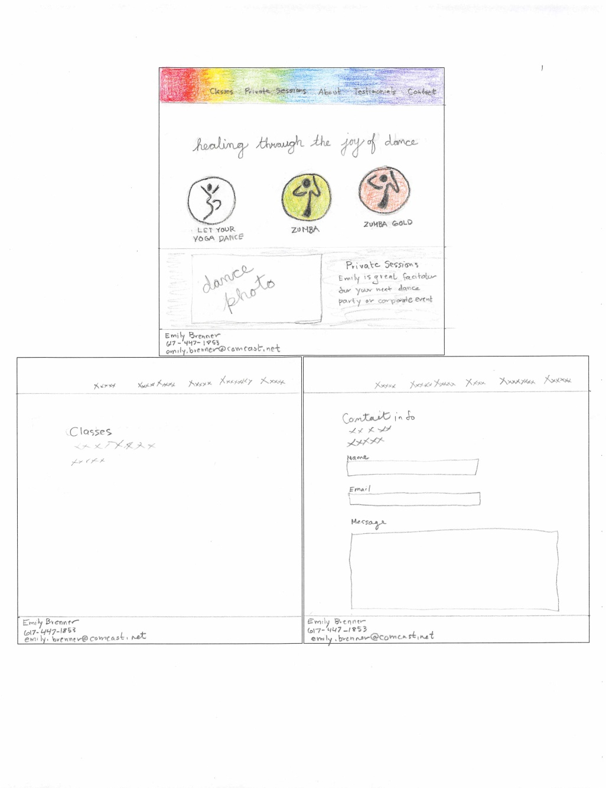
Sketches
Sketch used for the website
Elements use:
  Rainbow navigation bar
  Home page structure
  Footer with contact info

Slide 6
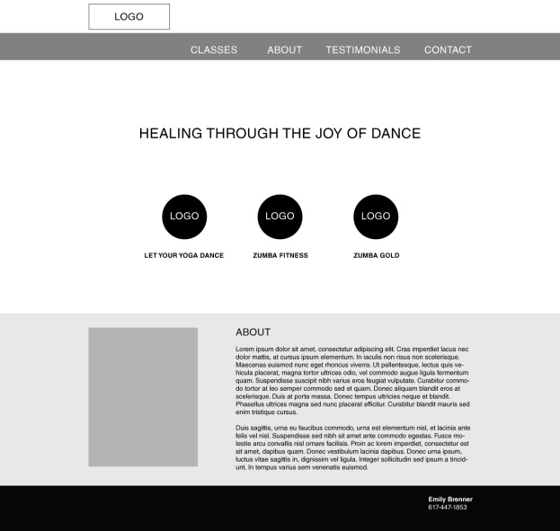
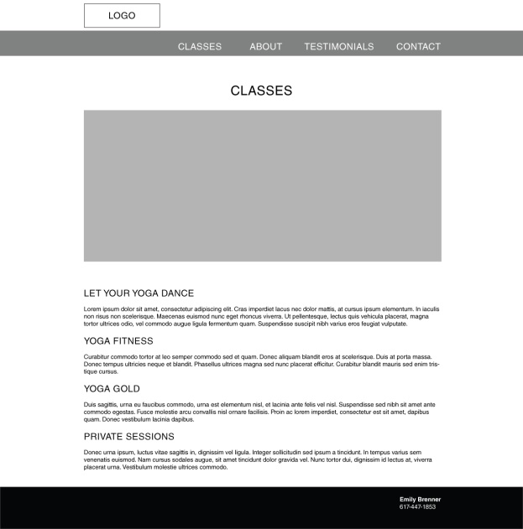
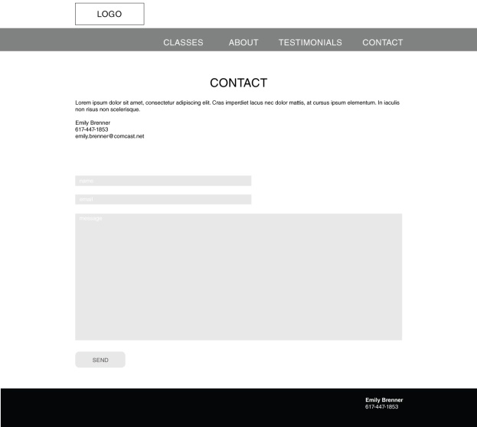
Wireframes
Changes
Placement of of mission
Class logos change to illustrations
Background on about disappears
Subpage photo becomes smaller and integrates with text
More use of white space
Footer text left aligns

Slide 7
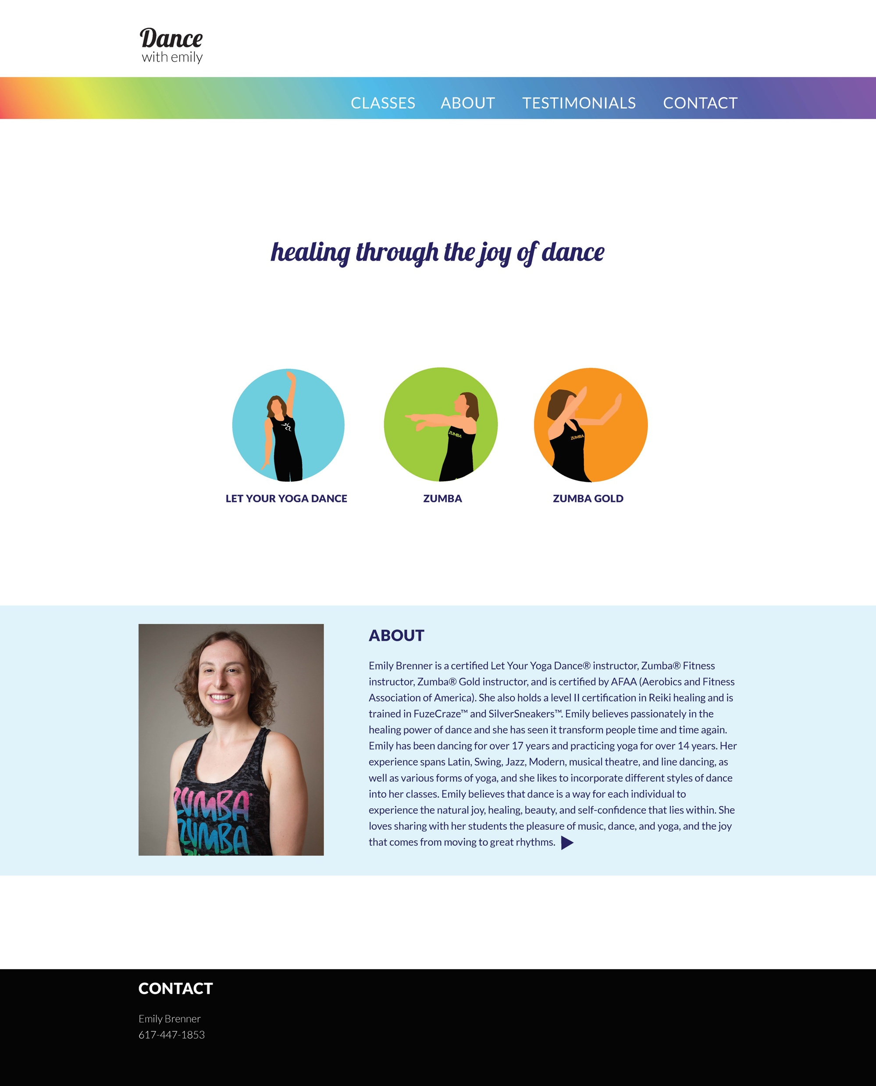
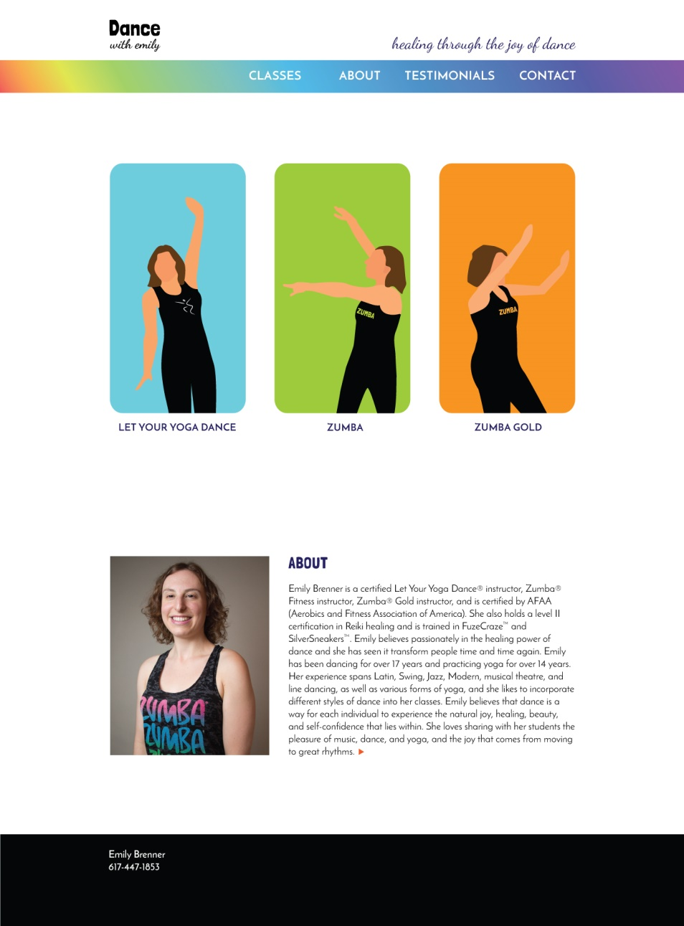
Prototype & New Website
New Website: https://zbordenet.github.io/

Slide 8
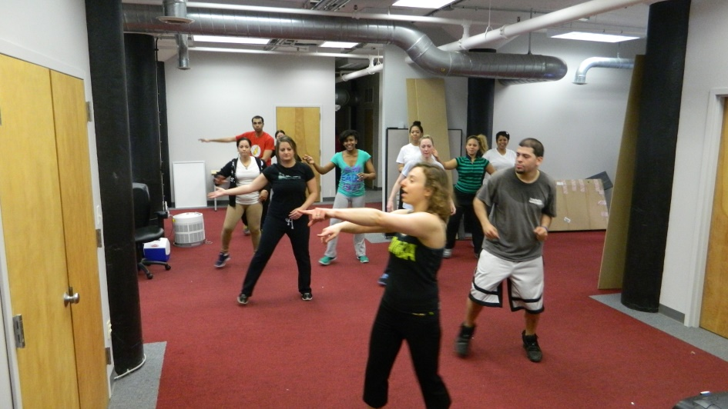
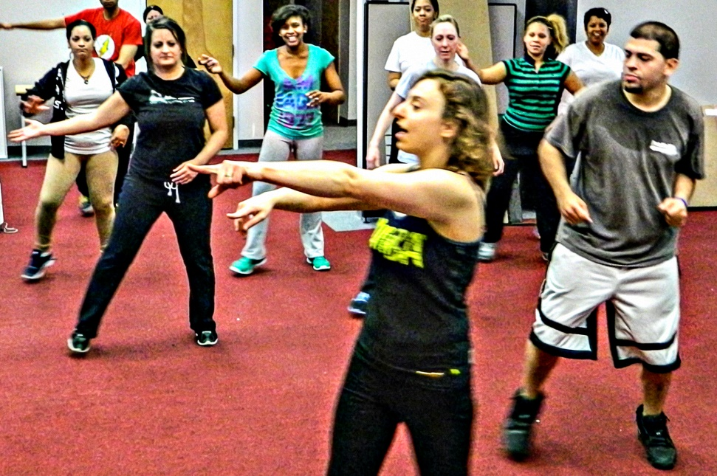
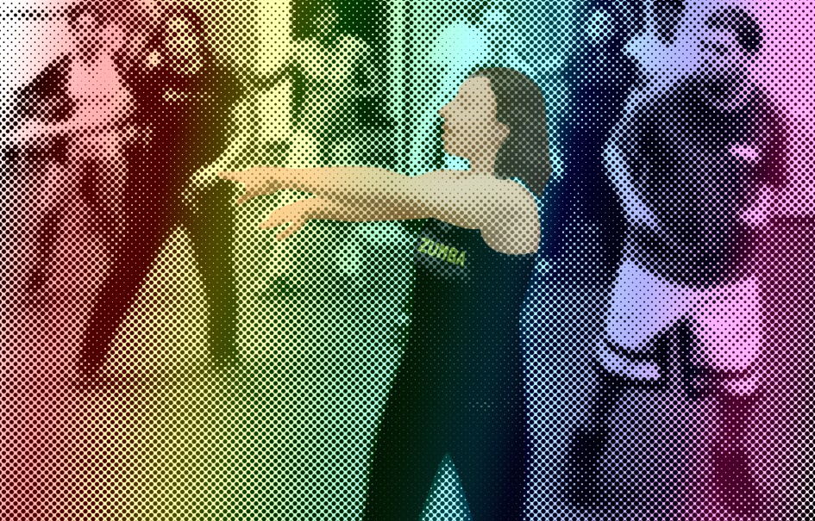
Challenges
1
3
2
1 Original photo
2 Photo with filters and illustration
3 Final image

Slide 9
Client Reaction & Next Steps
Client happy with the website
  New more readable format for schedule
  Illustrations and layout of home page
  Contact info on every page
  Edits to copy
New steps
  Client is interested in using website

Slide 10
Lessons Learned
learned a lot about web design from all the projects this semester
Importance of high resolution photography
Improve on identifying “boxes” for CSS

Slide 11
Thank you!

